Slide 1


Slide 2
Group 2
Members
Parrilla
Singson
Flordeliza
Cepe (corres)
Obias (corres)
Dela Carcel (corres)
Notes:
GROUP 2 uno

Slide 3
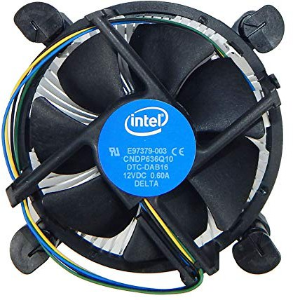
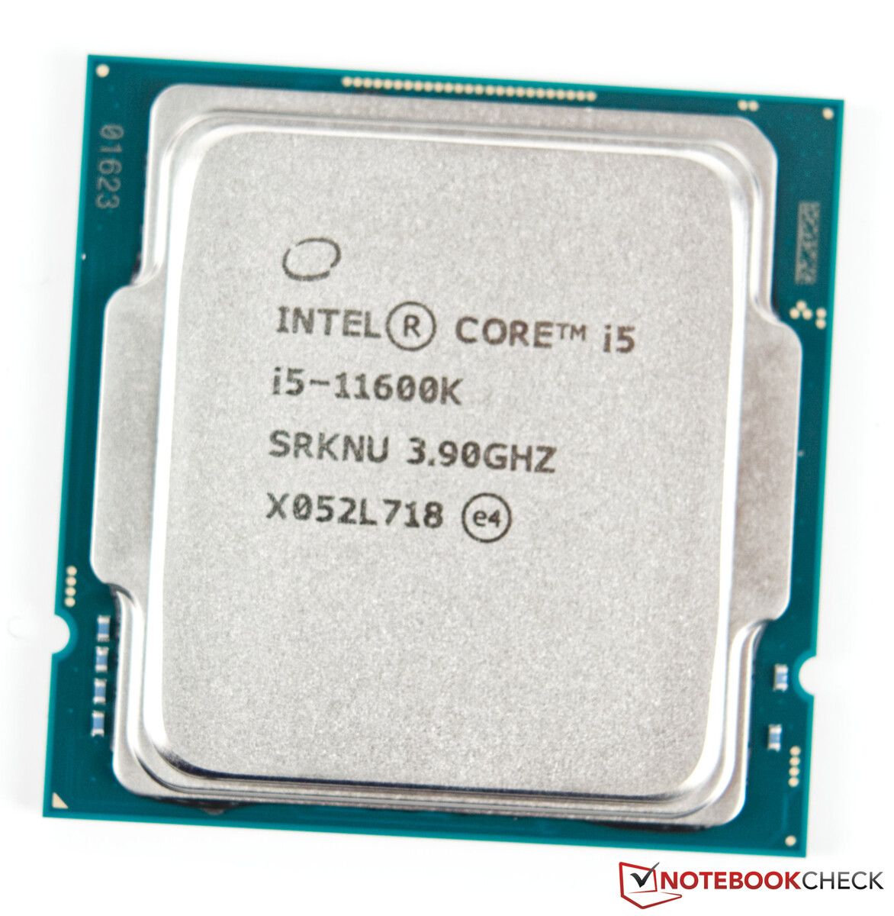
CPU fan for Intel® Core™ i5-11600K Processor
GROUP 2
CPUs running at default (non-overclocked) speeds
Notes:
FAN with Fuzzy Logic specifically designed for Intel® Core™ i5-11600K Processor
The CPU’s specs are default (non-overclocked or modified)

Slide 4
Simple Block Diagram of the CPU (i5-11600K Processor ) Fan Speed Controller
Tcase Temperature
(°C)
input
Fuzzy Logic Engine
(Fan Speed Controller)
output
Controlled Environment
(CPU i5-11600K)
Fan (RPM)
input
Clock speed
(GHz)
Clock speed frequency
(Tcase) Temp
Notes:
>Simple Block Diagram of the CPU Fan Speed Controller
Input yung (temperature at clock speed)
Yung mga RULES nasa Fuzzy Logic Engine
Out yung rpm ng fan
Then read ulit yung current CPU clock speed frequency pati Temp

Slide 5
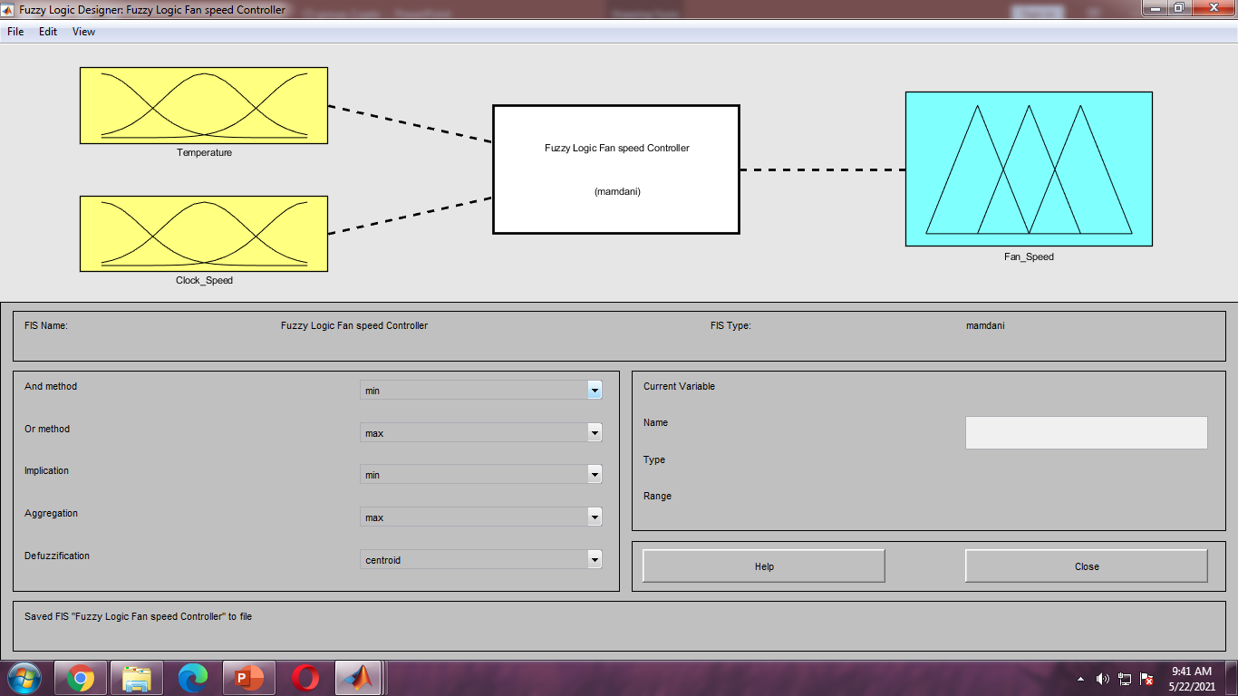
MATLAB
Notes:
Our Fuzzy logic system for Fan speed controller
Screenshot from MATLAB

Slide 6
Variables
Notes:
First step in implementing FL is to Decide exactly what is to be controlled and how

Slide 7
 | Linguistic Variables | Linguistic Values | Units | Ranges
INPUT | (Tcase) Temperature | Cool, Warm, Hot | Degree Celcius (°C) | 0-100
 | Clock speed frequency | Thermal throttling, Base, Boosting | Gigahertz (GHz) | 0-5
OUTPUT | Fan Speed | Slow, Fast | Revolution per minute (rpm) | 2000
Tcase is CPU temperature measurement taken from the center of the CPU's top surface (heat spreader). This temperature is measured by a diode embedded between the CPU cores.
It is useful for determining your CPU's idle temperature, normal temperature and maximum temperature.
Temperature Range is based from Intel Core i5 11600k processor benchmark – Max Temperature
Clock speed frequency Range is based from Intel Core i5 11600k processor benchmark – Max Turbo Frequency
Fan Speed Range is based from other existing fan’s RPM
Notes:
>First step in implementing FL is to Decide exactly what is to be controlled and how
>CPU Temperature = Tcase
Tcase is CPU temperature measurement taken from the center of the CPU's top surface (heat spreader). This temperature is measured by a diode embedded between the CPU cores.
It is useful for determining your CPU's idle temperature, normal temperature and maximum temperature.
>Ideal RPM
There is no universal answer.
It depends on your case and how cool you want the components to be.
The higher the rpm, in theory the more air flows through the case moving heat away from the hot parts and pushing it outside the case.
>GHz
When referring to a computer processor or CPU, GHz is a clock frequency, also known as a clock rate or clock speed, representing a cycle of time
>RPM
Revolutions per minute is the number of turns in one minute. It is a unit of rotational speed or the frequency of rotation around a fixed axis
> How to check CPU temp
https://www.buildcomputers.net/check-cpu-temperature.html
>Max temp Range source bechmark (100)
https://www.notebookcheck.net/Intel-Core-i5-11600K-Processor-Benchmarks-and-Specs.530301.0.html
>CPU Range source i5 specs (4.90Ghz)
https://www.intel.com/content/www/us/en/products/sku/212275/intel-core-i511600k-processor-12m-cache-up-to-4-90-ghz/specifications.html
>RPM range (2000)
https://finaldesktop.com/cpu-coolers/best-cpu-cooler-for-i5-11600k?fbclid=IwAR2P_z1PXW7mwlQOOW7wewyXH2GopeAtfUne5VBxm7hkrhUWHOHQe--WCCc

Slide 8
Membership function
Notes:
>The type of membership function is dependent on context and is generally chosen according to the user’s experience or the nature of the data.
>the membership functions for input and output variables are generated either from recommendations from experts such as automobile engineers or through clustering methods
>Note that an important characteristic of fuzzy logic is that a numerical value does not have to be fuzzified using only one membership function. In other words, a value can belong to multiple sets at the same time.

Slide 9
EXCEL
y= 0.05x-1.5
y= -0.05x+3.5
Notes:
>table for temperature
>to open yung excel, right click sa table then edit data → edit data in excel
para makuha niyo yung slope pati intercept sa loob ng excel
>Temperature Range is based from Intel Core i5 11600k processor benchmark – Max Temperature (slide 7 for link)
>The type of membership function is dependent on context and is generally chosen according to the user’s experience or the nature of the data.
>the membership functions for input and output variables are generated either from recommendations from experts such as automobile engineers or through clustering methods
>Note that an important characteristic of fuzzy logic is that a numerical value does not have to be fuzzified using only one membership function. In other words, a value can belong to multiple sets at the same time.

Slide 10
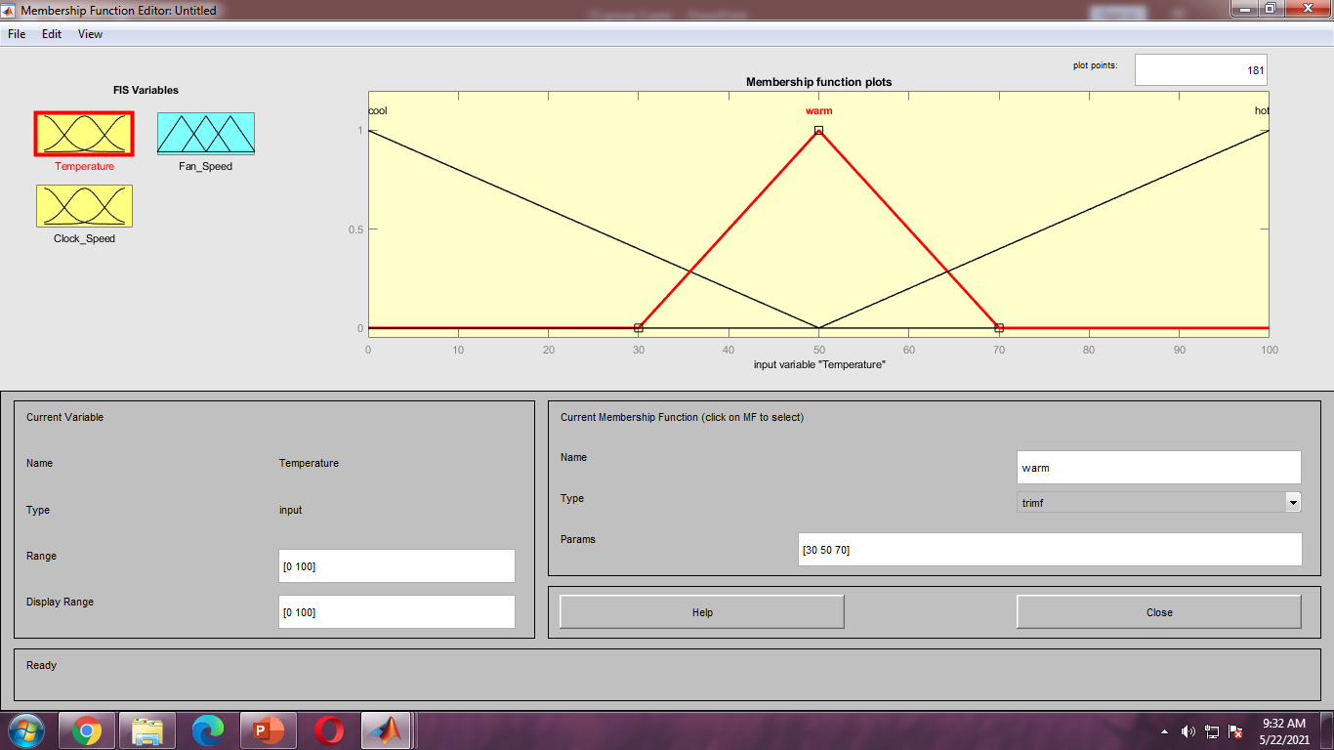
MATLAB
Notes:
>table for temperature
>Screen shot From MATLAB

Slide 11
EXCEL
y= 2x-6.8
y= -2x+8.8
Notes:
>table for Clock speed
>to open yung excel, right click sa table then edit data → edit data in excel
para makuha niyo yung slope pati intercept sa loob ng excel
>Clock speed frequency Range (base and Max) is based from Intel Core i5 11600k processor benchmark – Max Turbo Frequency (slide 7 for link)
>The type of membership function is dependent on context and is generally chosen according to the user’s experience or the nature of the data.
>the membership functions for input and output variables are generated either from recommendations from experts such as automobile engineers or through clustering methods
>Note that an important characteristic of fuzzy logic is that a numerical value does not have to be fuzzified using only one membership function. In other words, a value can belong to multiple sets at the same time.

Slide 12
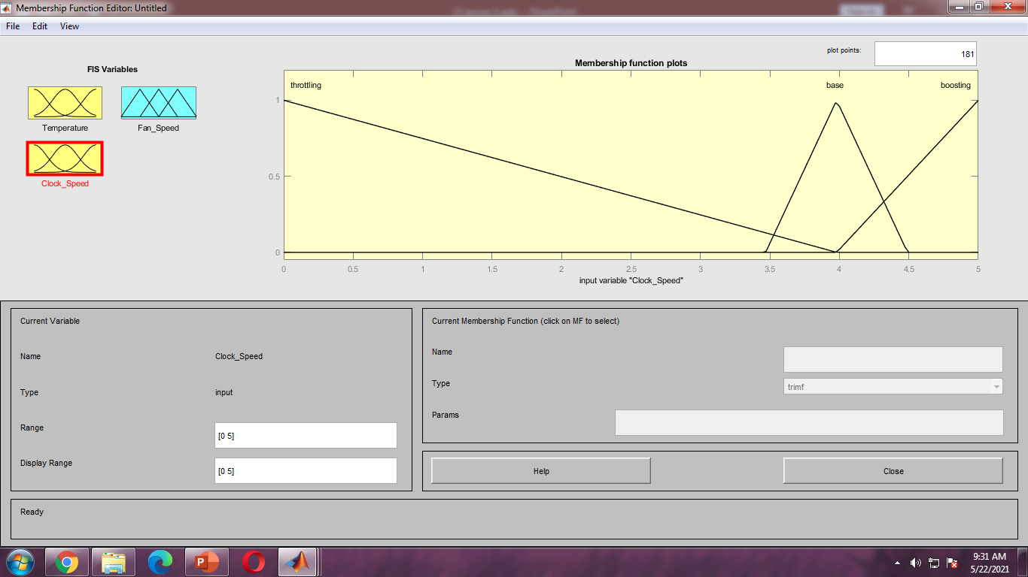
MATLAB
Notes:
>table for Clock Speed
>Screen shot From MATLAB

Slide 13
Notes:
>table for FAN speed
>to open yung excel, right click sa table then edit data → edit data in excel
para makuha niyo yung slope pati intercept sa loob ng excel
>Fan Speed Range is based from other existing fan’s RPM (slide 7 for link)
>The type of membership function is dependent on context and is generally chosen according to the user’s experience or the nature of the data.
>the membership functions for input and output variables are generated either from recommendations from experts such as automobile engineers or through clustering methods
>Note that an important characteristic of fuzzy logic is that a numerical value does not have to be fuzzified using only one membership function. In other words, a value can belong to multiple sets at the same time.

Slide 14
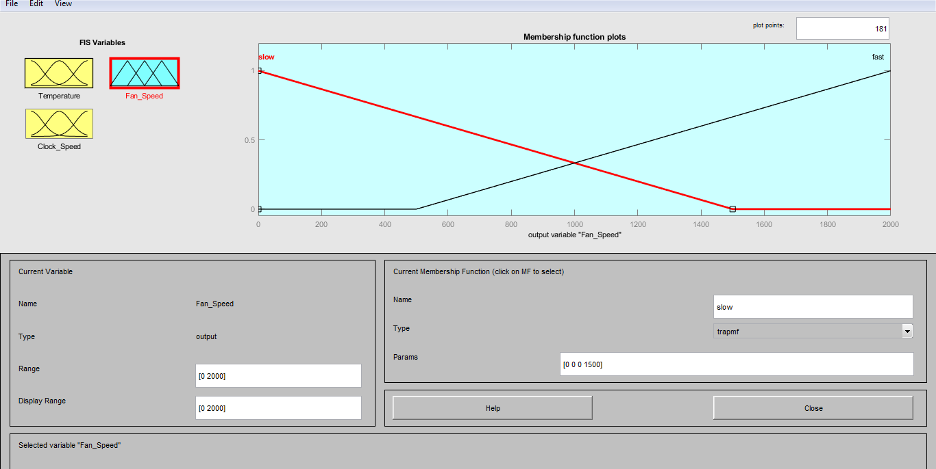
MATLAB
Notes:
>table for FAN speed
>Screen shot From MATLAB

Slide 15
Rules
 |  | Clock Speed (Thermal throttling, Base, Boosting) |  | Tcase Temperature (Cool, Warm, Hot) |  | Fan Speed (Slow, Fast)
1 | If | Thermal throttling | AND | Cool | THEN | Slow
2 | If | Thermal throttling | AND | Warm | THEN | Slow
3 | if | Thermal throttling | AND | Hot | THEN | Fast
4 | if | Base | AND | Cool | THEN | Slow
5 | if | Base | AND | Warm | THEN | Slow
6 | if | Base | AND | Hot | THEN | Fast
7 | if | Boosting | AND | Cool | THEN | Fast
8 | If | Boosting | AND | Warm | THEN | Fast
9 | if | Boosting | AND | Hot | THEN | Fast
Notes:
>Rules/condition
>Experts or training data can provide these rules or you can extract rules from the data itself, through clustering methods

Slide 16
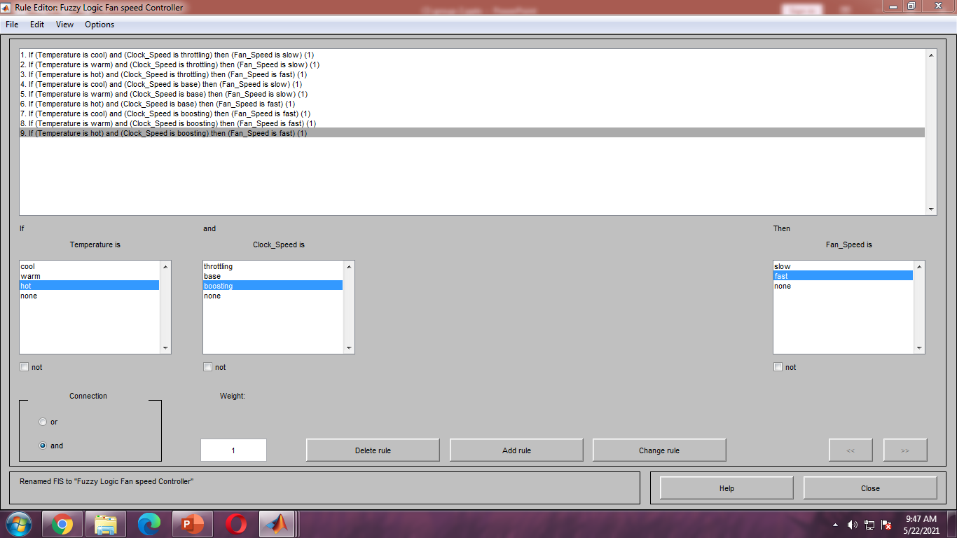
MATLAB Rules
Notes:
>Rules screenshot from MATLAB
>inside Fuzy logic Fan speed controller

Slide 17
Rule Matrix
Clock Speed TCase Temperature | Thermal Throttling | Base | Boosting
Cool | Slow | Slow | Fast
Warm | Slow | Slow | Fast
Hot | Fast | Fast | Fast
Notes:
>Our rule Matrix
>Experts or training data can provide these rules or you can extract rules from the data itself, through clustering methods

Slide 18
Test

Slide 19
-Thermal Throttle partition
Range: 1.0GHz to 3.8GHz
Test: 3.7Ghz at 75c
-Base Partition
Range: 3.9 - 4.3 GHz
Test 4.0 GHz at 55c
-Boosting
Range: 4.3 - 4.9 GHz
Test: 4.8GHz at 35c
Test
4.0 GHz and 55c
Notes:
>Yung sinend ni Jim
>3.7GHz is an average clock speed amongst today's processors but it is below the advertised base clock of the 11600k, we wanted to check the fan speed setting if it was below base clock at the CPU temperature of 75c
>With a 3.9 Ghz base clock, what speed setting should the cooler be if it was clocked just 100 GHz higher than base while at a temp of 55c
>Fan speed setting of a CPU air cooler if it was to maintain a boost clock of 4.8GHz at a low temp of 35c
Test
Minimum
Just Above the minimum
A nominal value
Just below the maximum
Maximum

Slide 20
Fuzzify and Apply the rules in Inferences

Slide 21
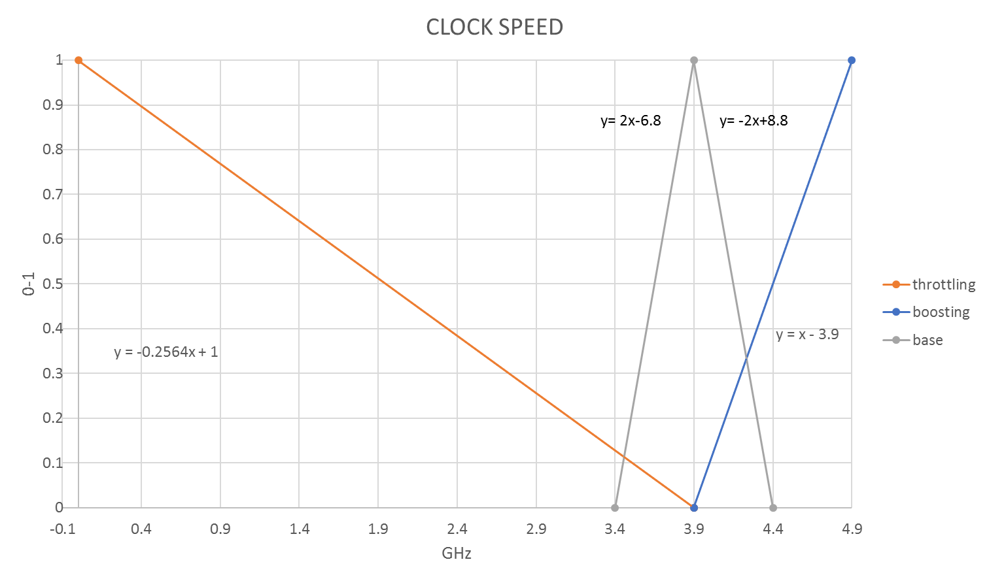
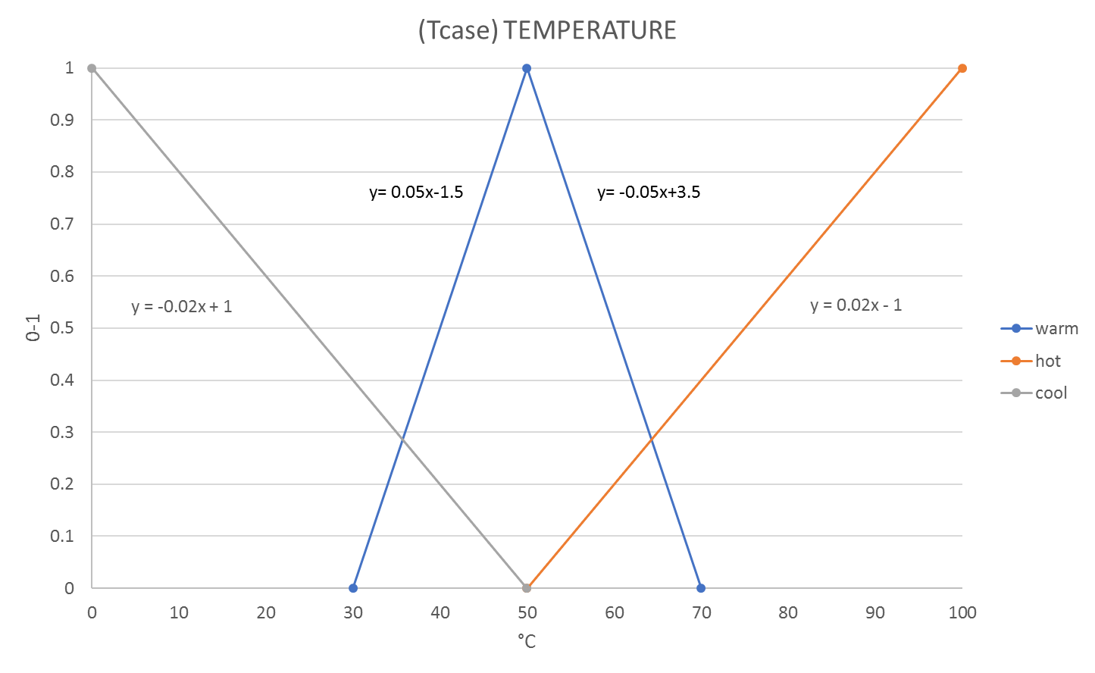
Base
mf= slope * input + offset
= -2 *4.0 + 8.8
= 0.8
Warm
mf= Right slope * input + Right offset
= -0.05 *55 + 3.5
= 0.75
5 | if | Base | AND | Warm | THEN | Slow
0.8 AND 0.75 THEN 0.75
Notes:
>AND = MINIMUM of the FTVs (lowest value between BASE and WARM)
>MANUAL COMPUTATION
>Satisfy/pasok sa Rule 5
>para makuha yung value nung slope at intercept,
1. go to their table
2. right click the table
3. edit data → edit data in Excel

Slide 22
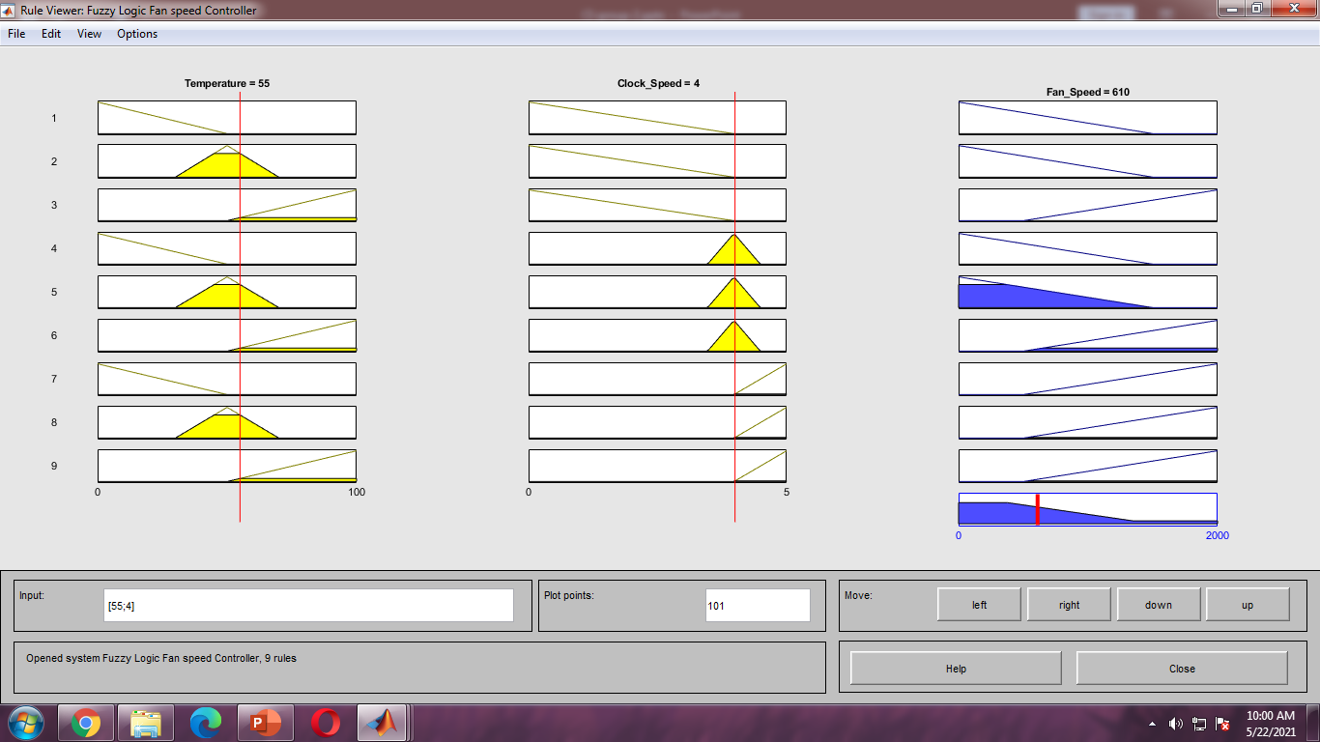
MATLAB
Temperature Clock Speed
Notes:
>Screen shot from MATLAB
>for rule 5

Slide 23
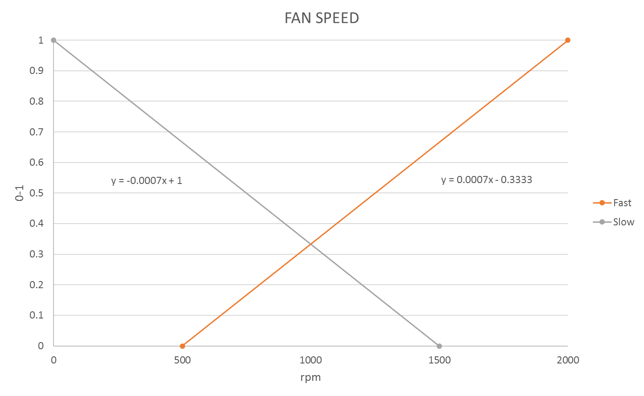
5 | if | Base | AND | Warm | THEN | Slow
0.8 AND 0.75 THEN 0.75
Notes:
>Result 0.75 SLOW

Slide 24
MATLAB
Fan_Speed
Notes:
>Screenshot of result from MATLAB
> Result 0.75 SLOW

Slide 25
Base
mf= slope * input + offset
= -2 *4.0 + 8.8
= 0.8
Hot
mf= slope * input + offset
= 0.02 *55 -1
= 0.1
6 | if | Base | AND | Hot | THEN | Fast
0.8 AND 0.1 THEN 0.1
Notes:
>AND = MINIMUM of the FTVs
>MANUAL COMPUTATION
>Satisfy/Pasok sa rule 6
>para makuha yung value nung slope at intercept,
1. go to their table
2. right click the table
3. edit data → edit data in Excel

Slide 26
MATLAB
Temperature Clock Speed
Notes:
>From MATLAB
>for rule 6

Slide 27
6 | if | Base | AND | Hot | THEN | Fast
0.8 AND 0.1 THEN 0.1
Notes:
>Result 0.1 FAST

Slide 28
MATLAB
Fan_Speed
Notes:
>From Matlab
>rule 6
>Result 0.1 FAST

Slide 29
Boosting
mf= slope * input + offset;
=1* 4.0 - 3.9
= 0.1
Warm
mf= Right slope * input + Right offset
= -0.05 *55 + 3.5
= 0.75
8 | If | Boosting | AND | Warm | THEN | Fast
0.1 AND 0.75 THEN 0.1
Notes:
>AND = MINIMUM of the FTVs
>MANUAL COMPUTATION
>Satisfy/ Pasok sa Rule 8
>para makuha yung value nung slope at intercept,
1. go to their table
2. right click the table
3. edit data → edit data in Excel

Slide 30
MATLAB
Temperature Clock Speed
Notes:
>Screenshot from MATLAB
>for Rule 8

Slide 31
8 | If | Boosting | AND | Warm | THEN | Fast
0.1 AND 0.75 THEN 0.1
Notes:
>Result 0.1 Fast
>Rule 8

Slide 32
MATLAB
Fan_Speed
Notes:
>Screenshot from MatLab
>rule 8
>Result 0.1 FAST

Slide 33
Boosting
mf= slope * input + offset;
=1* 4.0 - 3.9
= 0.1
Hot
mf= slope * input + offset
= 0.02 *55 -1
= 0.1
9 | if | Boosting | AND | Hot | THEN | Fast
0.1 AND 0.1 THEN 0.1
Notes:
>AND = MINIMUM of the FTVs
>MANUAL COMPUTATION
>Rule 9
>para makuha yung value nung slope at intercept,
1. go to their table
2. right click the table
3. edit data → edit data in Excel

Slide 34
MATLAB
Temperature Clock Speed
Notes:
>Result 0.1 Fast
>Rule 9

Slide 35
9 | if | Boosting | AND | Hot | THEN | Fast
0.1 AND 0.1 THEN 0.1
Notes:
>Result 0.1 Fast
>Rule 9

Slide 36
MATLAB
Fan_Speed
Notes:
>Screenshot from MatLab
>rule 9
>Result 0.1 FAST

Slide 37
Aggregation

Slide 38
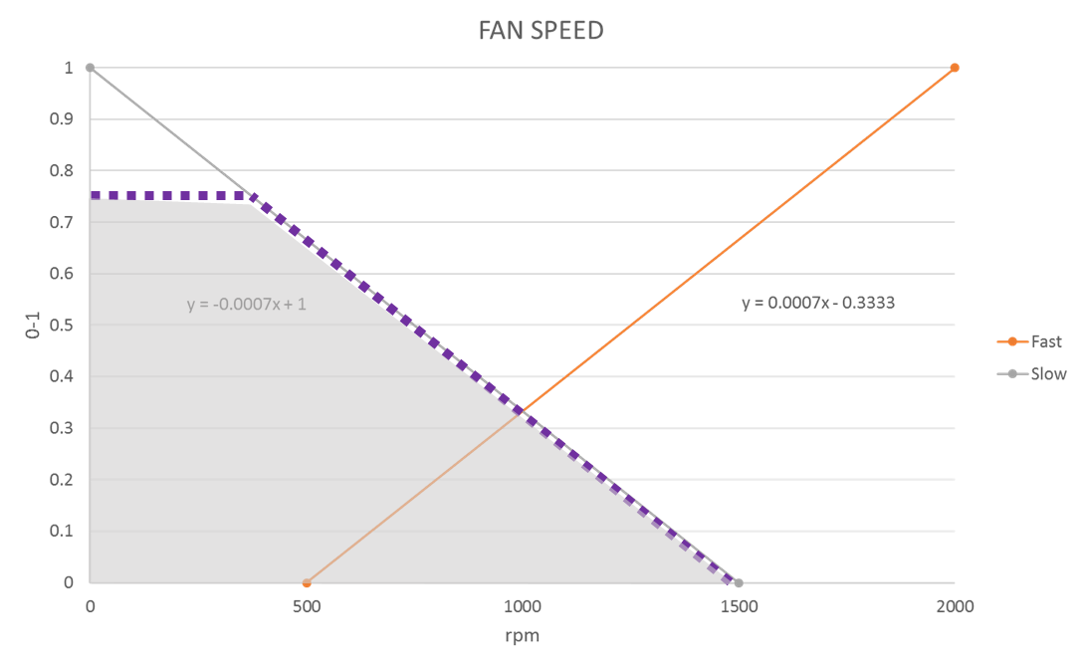
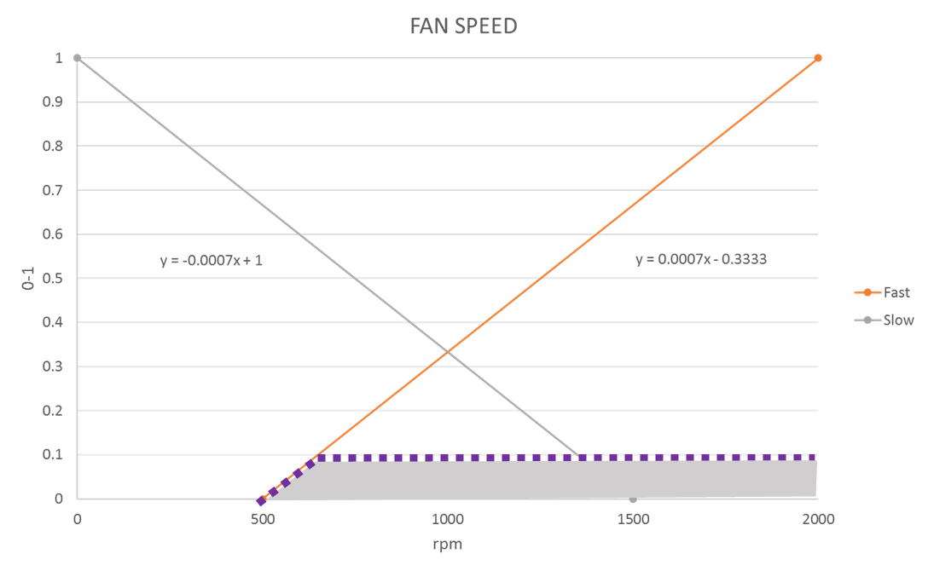
Aggregate
Rule: 5
Rule: 8
Rule: 6
Rule: 9
Notes:
Combine and consider all output of the rules
https://youtu.be/0I1BbIeTPv0?t=855
PINAKAMATAAS sa Slow
PINAKAMATAAS sa Fast

Slide 39
Aggregated
0.75 slow
Crisp function
0.1 fast
Notes:
Nasa baba yung table in excel (incase hanapin ☺)

Slide 40

MATLAB
Notes:
Screenshot from MatLab

Slide 41
Defuzzification

Slide 42
Notes:
Pag gusto niyo palabasin excel: Right click the table then edit data → Edit data in Excel

Slide 43
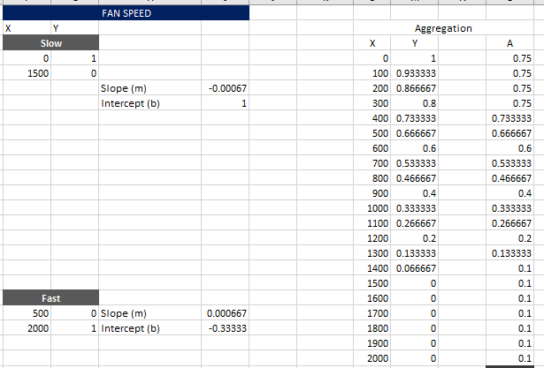
Excel
Notes:
>Excel to nung nasa baba :3
>Coordinates (X, A)
>By 100 (0, 100, 200, 300 etc.) lang yung ginawa ko sa x axis so 21 points
>Mas accurate sa MATLAB 101 Points ginamit satin 21 points lang

Slide 45
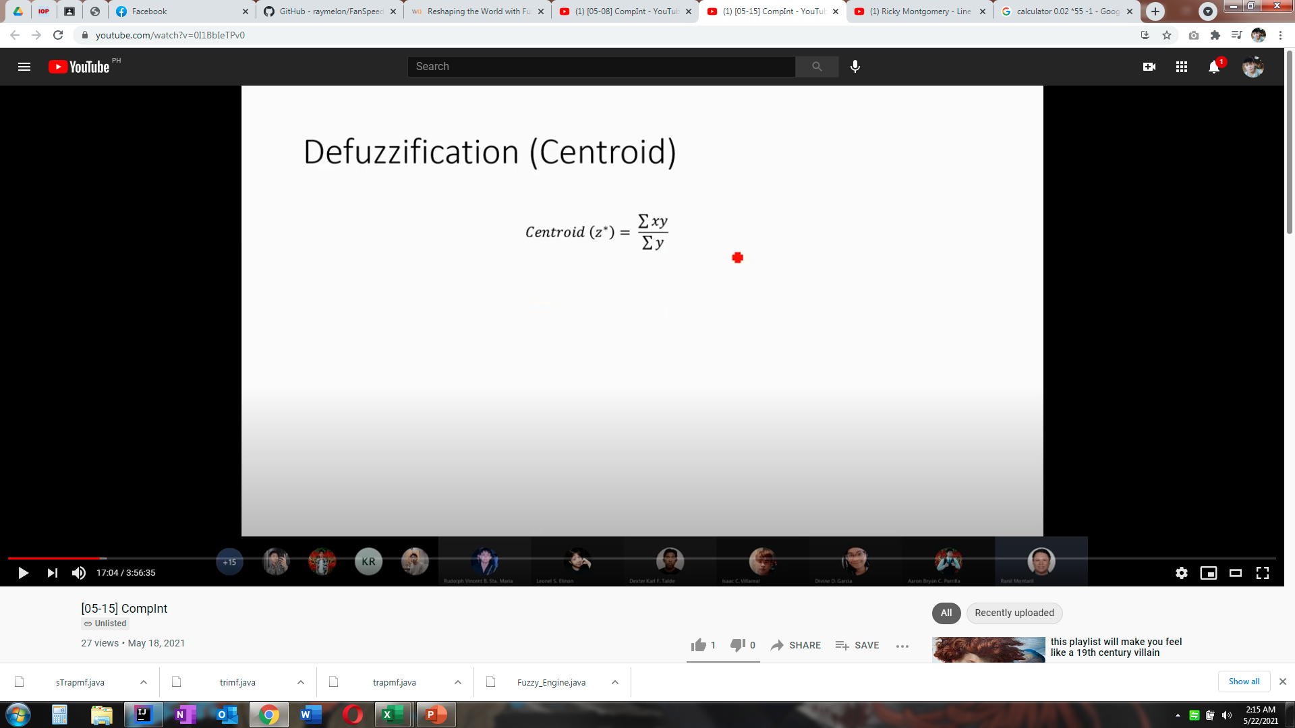
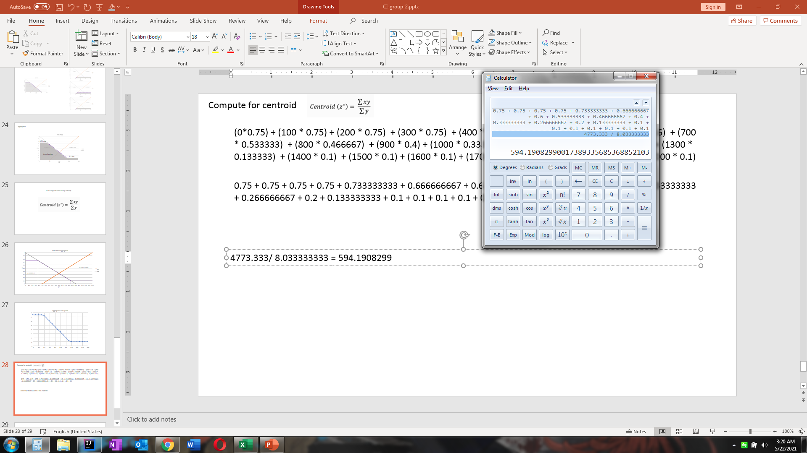
Compute for centroid (Manual)
(0*0.75) + (100 * 0.75) + (200 * 0.75) + (300 * 0.75) + (400 * 0.733333) + (500 * 0.666667) + (600 * 0.6) + (700 * 0.533333) + (800 * 0.466667) + (900 * 0.4) + (1000 * 0.333333) + (1100 * 0.266667) + (1200 * 0.2) + (1300 * 0.133333) + (1400 * 0.1) + (1500 * 0.1) + (1600 * 0.1) + (1700 * 0.1) + (1800 * 0.1) + (1900 * 0.1) + (2000 * 0.1)
Centroid (z*) =
0.75 + 0.75 + 0.75 + 0.75 + 0.733333333 + 0.666666667 + 0.6 + 0.533333333 + 0.466666667 + 0.4 + 0.333333333 + 0.266666667 + 0.2 + 0.133333333 + 0.1 + 0.1 + 0.1 + 0.1 + 0.1 + 0.1 + 0.1
Centroid (z*) =
4773.333 / 8.033333333 = 594.1908299
Notes:
Manual Computation

Slide 46
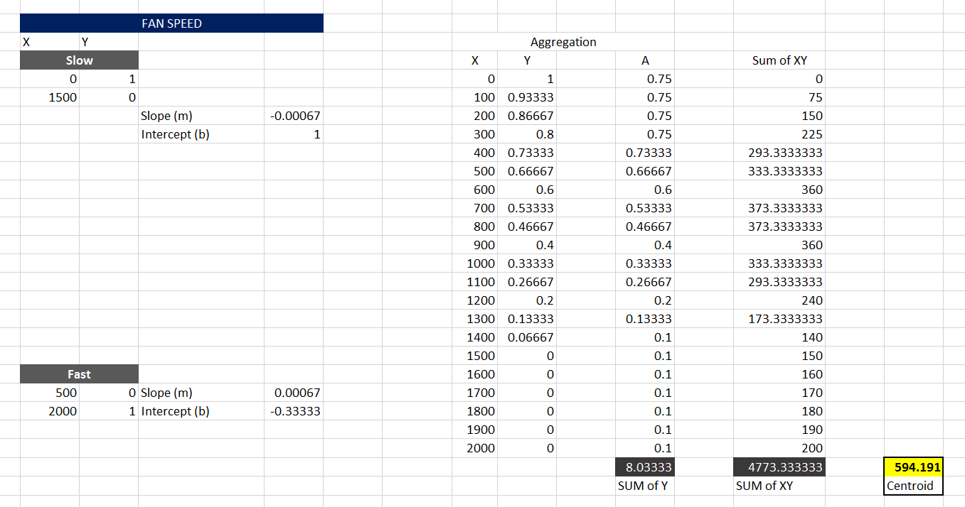
Compute for centroid (Excel)
Centroid (z*) =
594.191
Notes:
Computation in Excel

Slide 47
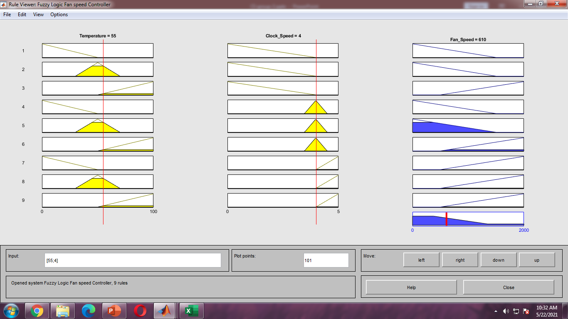
Compute for centroid (MATLAB) more accurate
Centroid (z*) =
610
Notes:
Computation in MatLaB

Slide 48
Result
for 4.0 GHz and 55c
Computation | Plot Points | Result (rpm)
Manual | 21 | 594.1908299
Excel | 21 | 594.191
MATLAB | 101 | 610
Notes:
>Plot points yung coordinates

Slide 49
End

